Slide 1
BlueFace Secure Lock
Antonio Boffa
Jacopo Massa
Elena Lepri
Giovanni Bartolomeo
Giulio Purgatorio

Slide 2


PROBLEM
ACCESS CONTROL
ACCESS POLICIES
SECURITY LEVELS
Who can access a room
User-defined & re-configurable policies
Multi-factor authentication

Slide 3
USE CASE
ROOM MANAGEMENT
REMOTE CONTROL
Office
House
…
MONITORING & REPORTING
Bluetooth inquiry
Room-by-room movements
Web Dashboard
… and much more

Slide 4
DESIGN ASPECTS
MULTI-FACTOR AUTHENTICATION
Face recognition ✔
Bluetooth ✔
NFC
One-time password
MODULARITY DOOR SIDE:
Camera service
Smart Lock service
Bluetooth Discovery service
SERVER SIDE:
Face Comparison service
Data storage (noSQL)
Monitoring & Logging
SCALABILITY
MQTT Broker
An MQTT Client for each door-side service

Slide 5
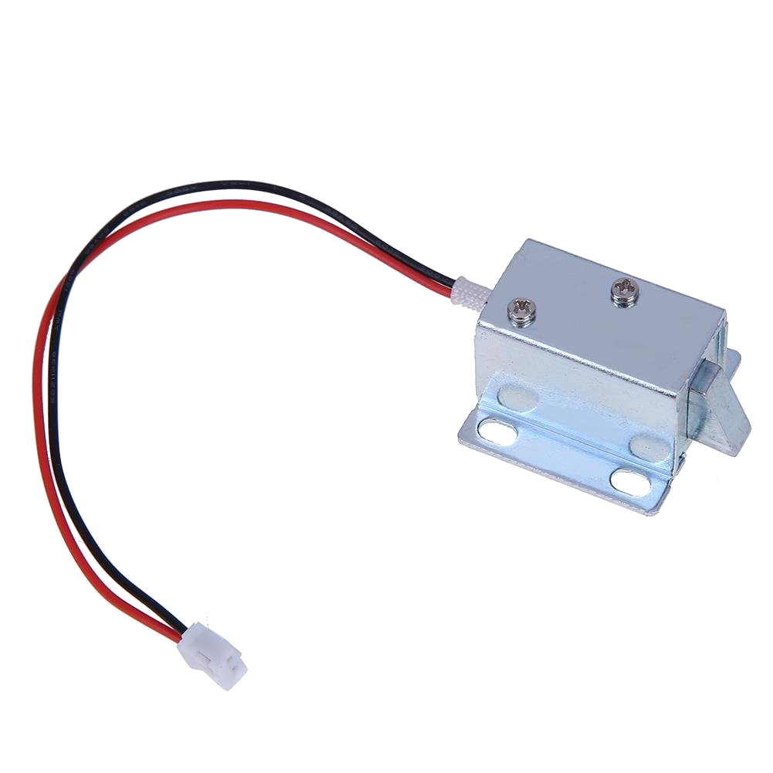






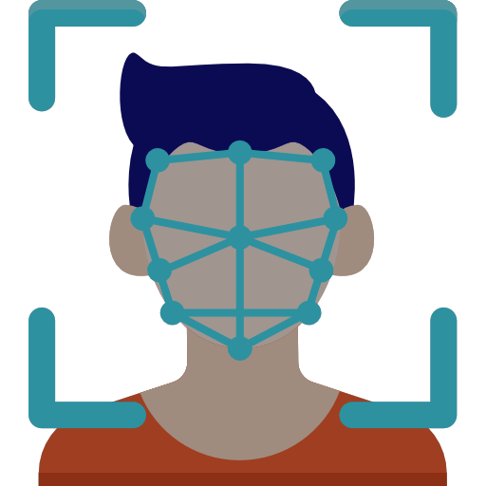

DOOR
door/<room_id>/open
bluetooth/discover
door/<room_id>/discover
door/<room_id>/open
door/<room_id>/discover
bluetooth/discover
DATABASE
FRONT-END
CENTRAL SERVICE

Slide 6
THANK YOU FOR YOUR ATTENTION! Now we will present a little demo

